Slide 1


REAL-TIME CLOCK
Experiment 5
Raphael S. Nano
CPE161P / A1
Computer Engineering Department
School of Electrical, Electronics, and Computer Engineering

Slide 2
Introduction: Real-Time Clock
A clock is just an instrument for measuring time
It can be digital or analog
A real-time clock moves at regular intervals indicated by seconds, minutes, and hours, and it is synchronized with the world’s standard time

Slide 3
Objectives
To demonstrate how a real-time clock works (hours-minutes-seconds).
To be able apply what you have learned in logic circuits and switching theory, microprocessors, and CPE160P.
To be able to apply real-time embedded system using arduino kit.

Slide 4
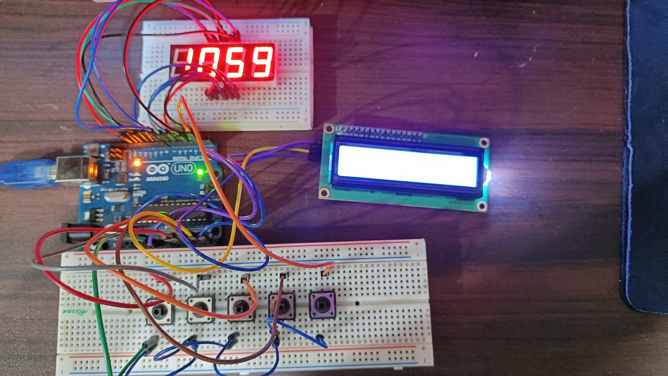
Materials
Hardware
Arduino Uno
4-digit Seven Segment Display
Liquid Crystal Display
5 Push Buttons

Slide 5

Materials
Software Libraries
LiquidCrystal_I2C.h
SevSeg.h
Notes:
For the external library, only the SevSeg.h was used, which is for the seven segment display.

Slide 6
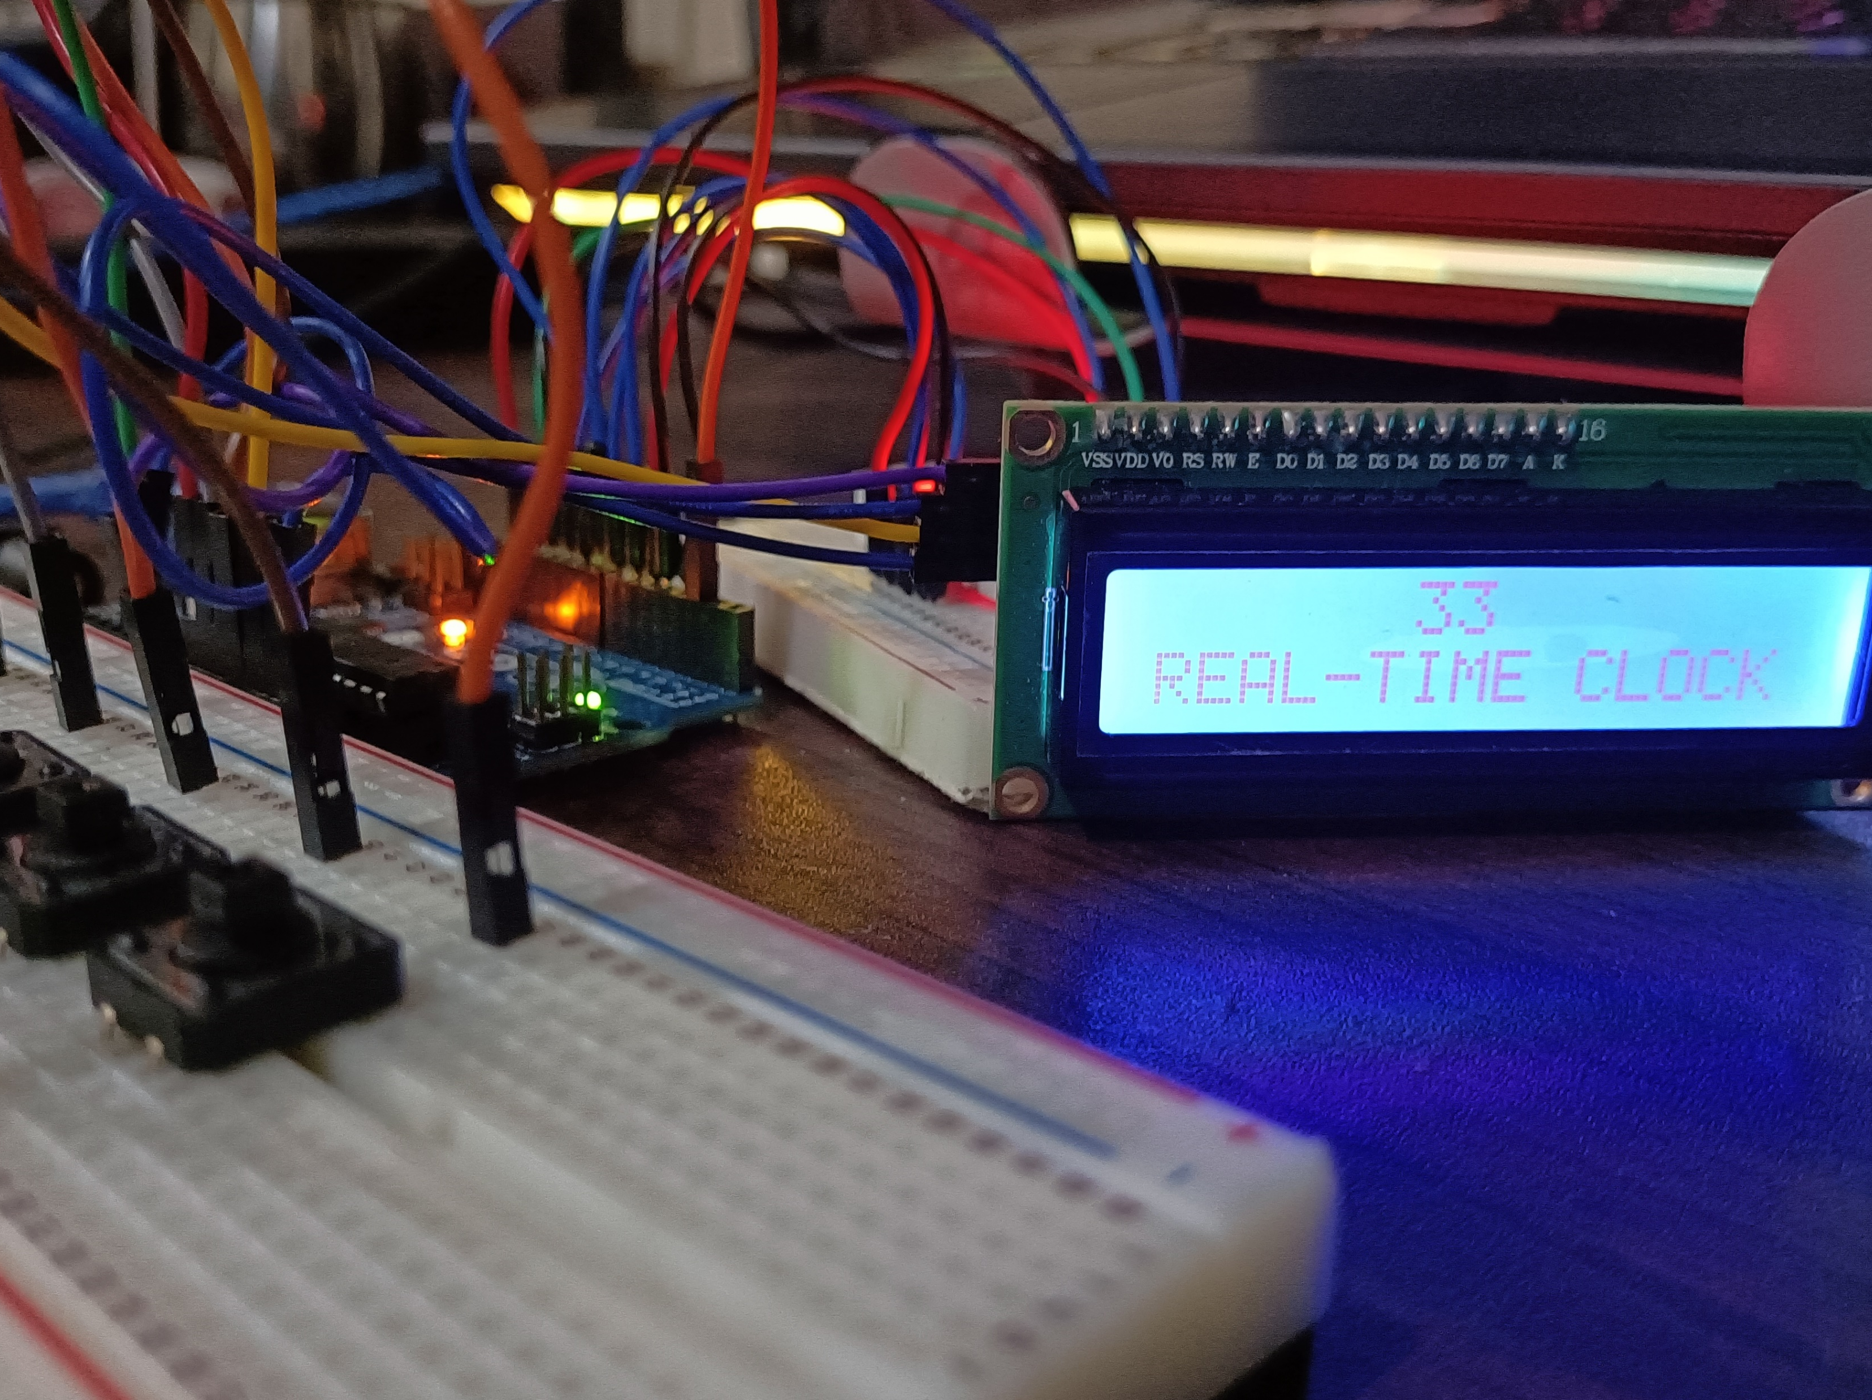
Discussion: Real-Time Clock
The current hour, minute, and second is being displayed for the output
With the use of the 5 push buttons, the user may manually adjust the clock to the current time.
Notes:
The first experiment primarily aims to demonstrate how a scoreboard for a basketball game works in real-time. Hence, there should be no delay in adjusting or changing the values of the seven-segment display every time a button was pushed down.
Two functions were used for the adjusting of points since there are two teams to be handled. So, team1() function is used for the adding or subtracting of values for the first two digits of the 4-digit seven segment display. On the other hand, team2() function is used to adjust the values for the rightmost two digits for the seven segment display. Although there are two separate functions, their purpose is the same, and only the digits to be considered are different.

Slide 7
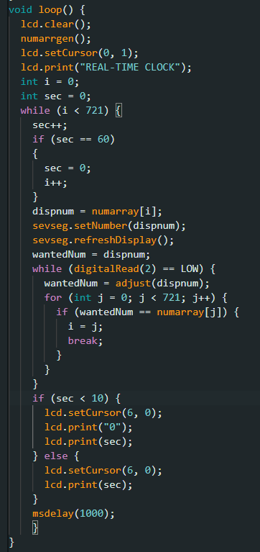
Discussion: Real-Time Clock
Three sections:
  Constant ticking of clock
  Increasing minutes or hours
  Decreasing minutes or hours
Output has a tick rate of 1000 ms
Seconds are displayed on the LCD
Minutes should increase from 1:00 to 1:01, and so on, in the SSD
Notes:
The first experiment primarily aims to demonstrate how a scoreboard for a basketball game works in real-time. Hence, there should be no delay in adjusting or changing the values of the seven-segment display every time a button was pushed down.
Two functions were used for the adjusting of points since there are two teams to be handled. So, team1() function is used for the adding or subtracting of values for the first two digits of the 4-digit seven segment display. On the other hand, team2() function is used to adjust the values for the rightmost two digits for the seven segment display. Although there are two separate functions, their purpose is the same, and only the digits to be considered are different.

Slide 8
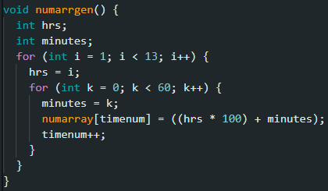
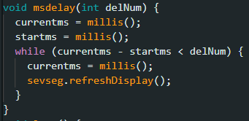
Discussion: Real-Time Clock
numarrgen() – number array generator
Stored numbers would be shown in the SSD
The delay was achieved by utilizing the millis() method
It assures the program-based timing of a minute delay without compromising the output in the SSD
Notes:
The first experiment primarily aims to demonstrate how a scoreboard for a basketball game works in real-time. Hence, there should be no delay in adjusting or changing the values of the seven-segment display every time a button was pushed down.
Two functions were used for the adjusting of points since there are two teams to be handled. So, team1() function is used for the adding or subtracting of values for the first two digits of the 4-digit seven segment display. On the other hand, team2() function is used to adjust the values for the rightmost two digits for the seven segment display. Although there are two separate functions, their purpose is the same, and only the digits to be considered are different.

Slide 9
Discussion: Real-Time Clock
The seconds of the clock continues to tick and is not allowed to be adjusted.
The fifth button enables the buttons for adjustment
First button increments hours
Second button decrements hours
Third button increments minutes
Fourth button decrements minutes
Code uses multiple if-else statements in verifying the pressed button
Notes:
The first experiment primarily aims to demonstrate how a scoreboard for a basketball game works in real-time. Hence, there should be no delay in adjusting or changing the values of the seven-segment display every time a button was pushed down.
Two functions were used for the adjusting of points since there are two teams to be handled. So, team1() function is used for the adding or subtracting of values for the first two digits of the 4-digit seven segment display. On the other hand, team2() function is used to adjust the values for the rightmost two digits for the seven segment display. Although there are two separate functions, their purpose is the same, and only the digits to be considered are different.

Slide 10
Conclusion
The real-time clock works in 3 functions:
  Constant ticking of time in the SSD and LCD
    Clock is continuous and is synchronized with the seconds, minutes, and hours of a standard clock
  Incrementing of Minutes and Hours
  Decrementing of Minutes and Hours

Slide 11
Conclusion
Proven by the success in creating the real-time clock with the use of various functions, real-time modules, and circuit connections, topics in logic circuits and switching theory, microprocessors, and especially CPE160P were fully implemented.
Hence, a digital clock was created and is operating appropriately as an application of a real-time embedded system.

